Slide 1

A Framework for Preparing and Assessing Cybersecurity Datasets
Bachlorarbeit im Fach Informatik
Wladimir Urban
11.11.2025
Betreuer:
Prof. Dr.-Ing. Reinhard German
Dr.-Ing. Loui Al Sardy
Mamdouh Muhammad, M. Sc.
Notes:
00:15

Slide 2
Agenda
Introduction
Related Work
Methodology
Case Study
Challenges and Limitations
Future Work
Conclusion

Slide 3
Introduction

Slide 4
Introduction
Motivation & Problems
Documentation gaps
Ambiguous collection procedures
Missing/unclear label semantics
Label quality issues
Inconsistent labels across files/sources
Class imbalance & rare attacks
Concept drift & timestamp incoherence
Feature instability
Changing feature sets, undefined units/scales
Mixed types (numeric/categorical/strings)
Hidden leakage
Temporal leakage in random splits
Duplicate flows/packets across splits
Inflated cross‑validated performance
Poor external validity
Inconsistent baselines across studies
Reproducibility issues
Deployment risk (models mis-handle minority attacks)
Notes:
01:30

Slide 5
Introduction
Research Questions and Contributions
Contributions
Framework A.R.C. (Automated Research for Cybersecurity)
Dataset-centric validation (schema/label/time)
Split integrity checks (random/stratified/time)
Preprocessing presets per model (RF/GBDT/SVM/MLP/LR)
Comparable evaluation and reporting (RAW vs PRE)
Empirical Study
2 datasets (DNP3 [1], CIC-IIoT [2])
5 learners
Research Questions
Does standardized preprocessing improve predictive performance across datasets/models?
Does standardized preprocessing reduce resource costs?
Is it possible to produce fully reproducible, audit-ready runs with minimal manual effort?
Notes:
02:30

Slide 6
Related Work

Slide 7
Related Work
Overview
TensorFlow Extended (TFX) [3]
Toolkit for defining, running and monitoring end to end ML pipelines
Has component libraries (e.g. TFDV, TFT)
Kubeflow Pipelines (KFP) [4]
Kubernetes-native platform to build and run ML workflows as DAGs (Components)
Focuses on orchestration and tracking
MLflow [5]
ML lifecycle tooling for experiment tracking
Apache Airflow [6]
General purpose workflow orchestrator
Author/schedule/monitor DAGs of tasks
Notes:
03:00
DAG = Directed Acyclic Graph

Slide 8



Related Work
Comparison
Overview of widely used ML infrastructure frameworks in comparison to the goals of this thesis
Aspect | A.R.C. | TensorFlow Extended (TFX) [3] | Kubeflow Pipeline (KFP) [4] | MLflow [5] | Apache Airflow [6]
Dataset readiness
Splitting (Time-aware)
Preprocessing built in
RAW vs. PRE evaluation
Reproducibility artifacts
Cybersecurity alignment
Included
Needs custom code
Not included
Notes:
05:00
TFDV – DATA VALIDATON
TFT – TRANSFORM
TFMA – MODEL ANALYSIS (Parallel branch)
TFMD – Metadata

Slide 9
Related Work
Positioning
End to end framework
Before training:
Schema & label validation
Leakage safe splits
Documented preprocessing
Training
After training:
Model performance Evaluation (with comparison)
Overall:
Detailed documentation for reproducibility
Report for audits
Artifacts export
Notes:
06:00

Slide 10
Methodology

Slide 11
Methodology
Software Stack
Python as foundation
Streamlit for the UI
Pandas and NumPy for data handeling
Scikit-learn and imbalanced-learn for modeling
Plotly and ReportLab for reporting
Notes:
06:30

Slide 12
Methodology
Design Principles
Modularity
Atomic modules
Separation of concern
Extensibility
New methods can be added without rewriting legacy code
Reproducibility
Every step is logged
Seeds can be configured
Human and machine-readable metadata
Transparency
Structured logs per step
Build on open-source libraries
Results presented with visuals
Notes:
07:30

Slide 13
Methodology
High-level Architecture
Data ingestion
Validation
Splitting
Pre
processing
Modeling & Evaluation
Reporting
A.R.C
Data
Loader
Schema
Validator
Label
Validator
Splitter
Pre-
processor
Trainer &
Evaluator
Comparer
Reporter
Notes:
08:00

Slide 14
Methodology
Dataflow
RAW dataset(s)
A.R.C
Data Loader
Schema
Validator
Label
Validator
Splitter
Pre-
processor
Trainer &
Evaluator
Comparer
Reporter
Notes:
08:05

Slide 15
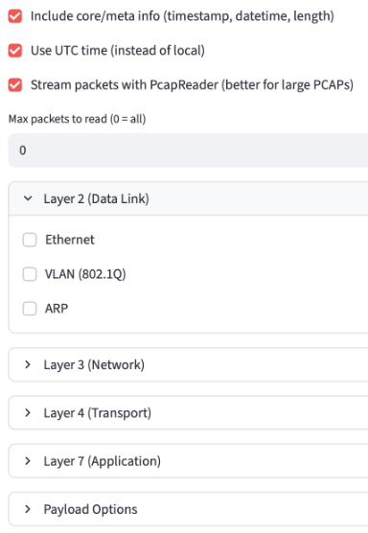
Methodology
Data Loader Module
Single CSV
Single TXT
Muliple CSVs
Single PCAP
Single PCAPNG
Read files
Merge files
Capture specified packets
Normalize to a pandas dataframe
DATA LOADER
Log data
Set label column
Detect and set time column
Show insights
Safe to session_state
Dataset as CSV
Configuration for PCAP / PCAPNG files
Notes:
09:00

Slide 16
Methodology
Dataflow
RAW dataset(s)
A.R.C
Data Loader
Schema
Validator
Label
Validator
Splitter
Pre-
processor
Trainer &
Evaluator
Comparer
Reporter
Dataset
as CSV
Notes:
09:05

Slide 17
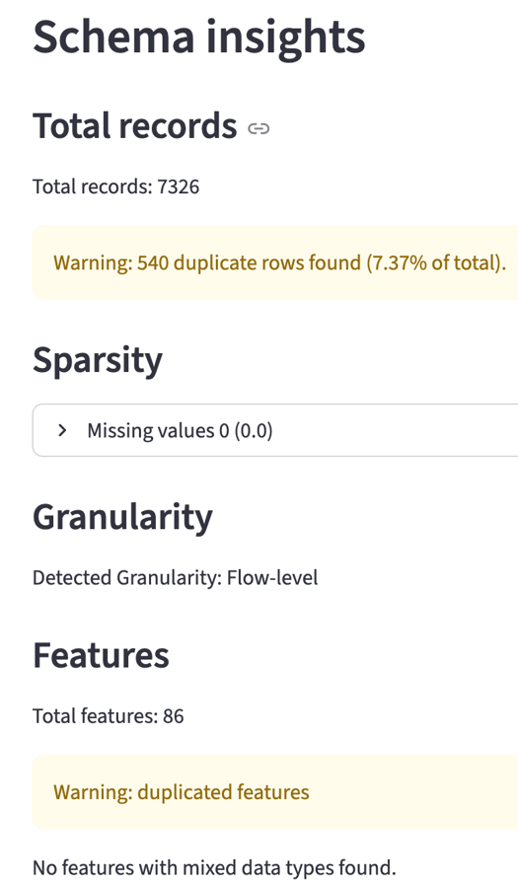
Methodology
Schema Validator Module
session_state
Dataset
Schema insights:
Records
Sparsity
Granularity
Features
Timespan
Feature presence
Schema modification:
Normalize feature names
Rename feature
Sort by timestamp
Add time delta
Drop features
SCHEMA VALIDATOR
Log data
Safe to session_state
Dataset as CSV
Example for UI of the Schema Validator
Notes:
10:00

Slide 18
Methodology
Dataflow
RAW dataset(s)
A.R.C
Data Loader
Schema
Validator
Label
Validator
Splitter
Pre-
processor
Trainer &
Evaluator
Comparer
Reporter
Dataset
as CSV
Notes:
10:05

Slide 19
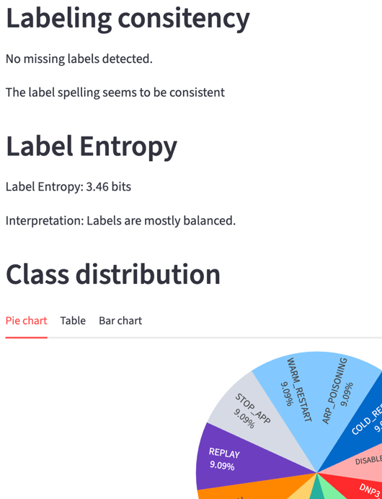
Methodology
Label Validator Module
session_state
Dataset
Label insights:
Label consistency
Label entropy
Class distribution
Rare classes
Dominant classes
Temporal drift
Label modification:
Rename label
LABEL VALIDATOR
Log data
Safe to session_state
Dataset as CSV
Example for UI of the Label Validator
Notes:
10:45

Slide 20
Methodology
Dataflow
RAW dataset(s)
A.R.C
Data Loader
Schema
Validator
Label
Validator
Splitter
Pre-
processor
Trainer &
Evaluator
Comparer
Reporter
Dataset
as CSV
Notes:
10:50

Slide 21
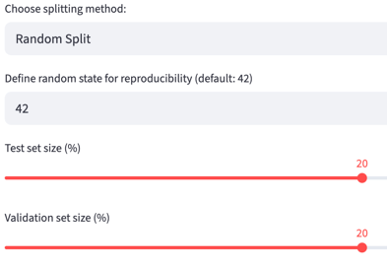
Methodology
Splitter Module
session_state
Splitting methods
Random split
Stratified split
Time-based split
Subsets:
Train
Validate
Test
Dataset
Splitting
SPLITTER
Quality checks:
Unseen labels
Label distribution
Safe to session_state
Log data
Configuration for splitting
Splitted datasets as CSV
Notes:
11:30

Slide 22
Methodology
Dataflow
RAW dataset(s)
A.R.C
Data Loader
Schema
Validator
Label
Validator
Splitter
Pre-
processor
Trainer &
Evaluator
Comparer
Reporter
Dataset
as CSV
Splitted datasets as CSV
Notes:
11:35

Slide 23
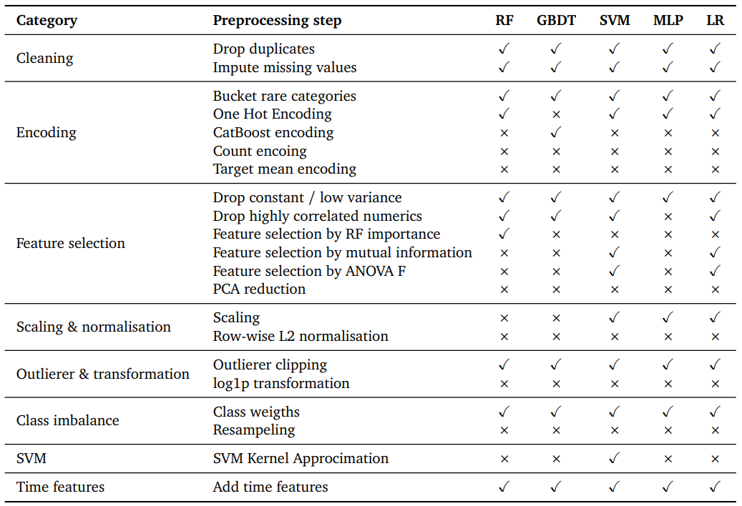
Methodology
Preprocessor Module
Overview of preprocessing steps applied per model
session_state
Splitted subsets
Configure preprocessing
PREPROCESSOR
Apply preprocessing
Safe to session_state
Log data
Pre-processed datasets as CSV
Metadata as JSON
Notes:
12:45

Slide 24
Methodology
Dataflow
RAW dataset(s)
A.R.C
Data Loader
Schema
Validator
Label
Validator
Splitter
Pre-
processor
Trainer &
Evaluator
Comparer
Reporter
Dataset
as CSV
Splitted datasets as CSV
Pre-processed datasets as CSV
Metadata as JSON
Notes:
12:50

Slide 25
Methodology
Trainer and Evaluator Module
session_state
Preprocessed subsets
Preprocessing meta data
Train model (RF, GBDT, SVM, MLP, LR)
Evaluation
Safe to
session_state
Log data
Per model metrics:
Training time
Model size
Feature count
Per split metrics:
Accurancy
F1 (macro)
Persicion (macro)
Recall (macro)
ROC-AUC
Interference time
Visuals:
Confusion matrix
ROC curve
Percision recall
Feature importance
TRAINER & EVALUATER
Trained model as PKL
Model metrics as JSON
Notes:
14:00

Slide 26
Methodology
Dataflow
RAW dataset(s)
A.R.C
Data Loader
Schema
Validator
Label
Validator
Splitter
Pre-
processor
Trainer &
Evaluator
Comparer
Reporter
Dataset
as CSV
Splitted datasets as CSV
Pre-processed datasets as CSV
Trained model with PRE data
PRE metrics
Metadata as JSON
Notes:
14:05

Slide 27
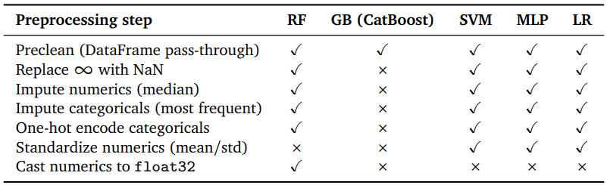
Methodology
Comparer Module
session_state
Minimal preprocessing
Overview of minimal preprocessing steps applied per model
Notes:
14:30

Slide 28
Methodology
Comparer Module
session_state
Minimal preprocessing
Preprocessed model
Preprocessing model metrics
Preprocessing meta data
Train RAW model (RF, GBDT, SVM, MLP, LR)
Evaluation
Safe to
session_state
Log data
Per model metrics:
Training time
Model size
Feature count
Per split metrics:
Accurancy
F1 (macro)
Persicion (macro)
Recall (macro)
ROC-AUC
Interference time
Visuals:
Confusion matrix
ROC curve
Percision recall
Feature importance
COMPARER
Trained model as PKL
Model metrics as JSON
Notes:
15:00

Slide 29
Methodology
Dataflow
RAW dataset(s)
A.R.C
Minimal preprocessing
Data Loader
Schema
Validator
Label
Validator
Splitter
Pre-
processor
Trainer &
Evaluator
Comparer
Reporter
Dataset
as CSV
Splitted datasets as CSV
Pre-processed datasets as CSV
Trained model with PRE data
Trained model with RAW data
PRE metrics
RAW metrics
Metadata as JSON
Notes:
15:05

Slide 30
Methodology
Dataflow
RAW dataset(s)
A.R.C
Minimal preprocessing
Data Loader
Schema
Validator
Label
Validator
Splitter
Pre-
processor
Trainer &
Evaluator
Comparer
Reporter
Dataset
as CSV
Splitted datasets as CSV
Pre-processed datasets as CSV
Trained model with PRE data
Trained model with RAW data
PDF report
Logfile
as TXT
PRE metrics
RAW metrics
Metadata as JSON
Notes:
15:15

Slide 31
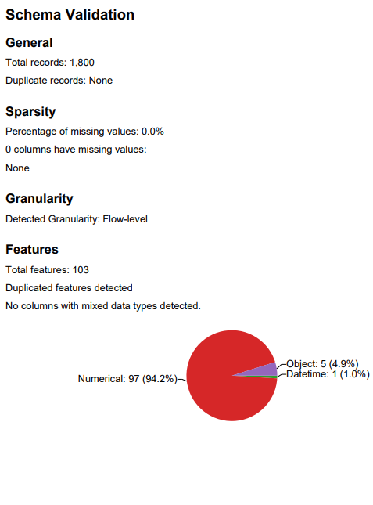
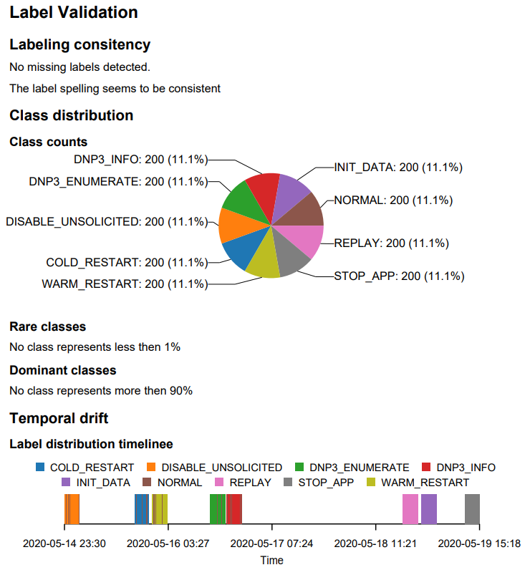
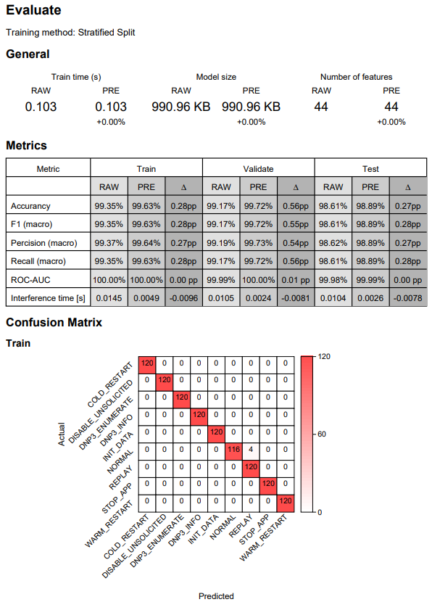
Methodology
Examples from a report
Screenshot PDF-Report Schema Validator
Screenshot PDF-Report Label Validator
Screenshot PDF-Report Trainer & Evaluator
Notes:
15:30

Slide 32
Case Study

Slide 33
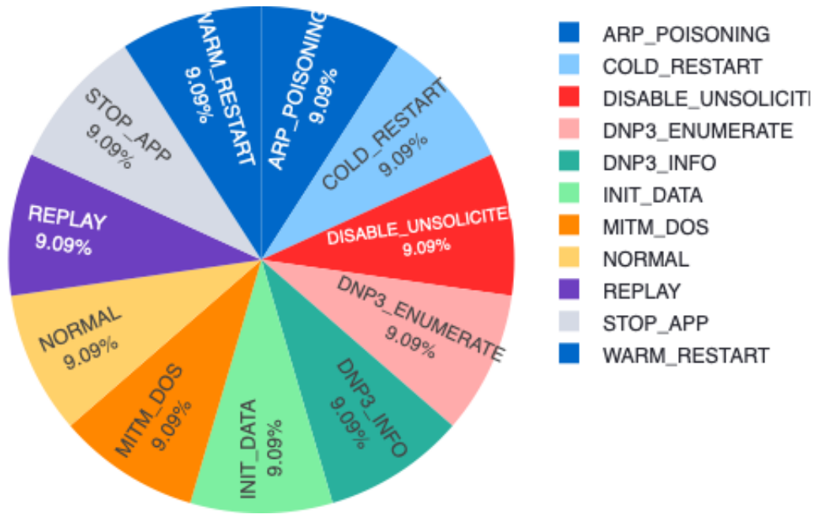
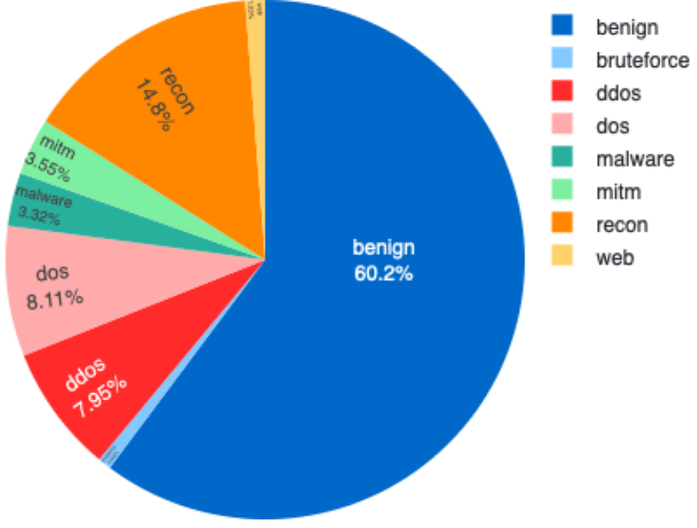
Case Study
Experiment
2 Datasets
Split method: Stratified-Split (60/20/20)
Models:
Random Forest (RF)
Gradient Boosted Decision Trees (GBDT)
Support Vector Machines (SVM)
Multi Layer Perceptrons (MLP)
Logistic Regression (LR)
Overview of used datasets
Dataset | Year | Records | Attack types | Disk size | Features | Synthetic
DNP3 [1] | 2022 | 7.326 | 10 | 4,4 MB | 86 | Yes
CIC-IIoT [2] | 2025 | 227.191 | 7 | 820,5 MB | 87 | Yes
DNP3 [1] Class Distribution
CIC-IIoT [2] Class Distribution
Notes:
16:15

Slide 34
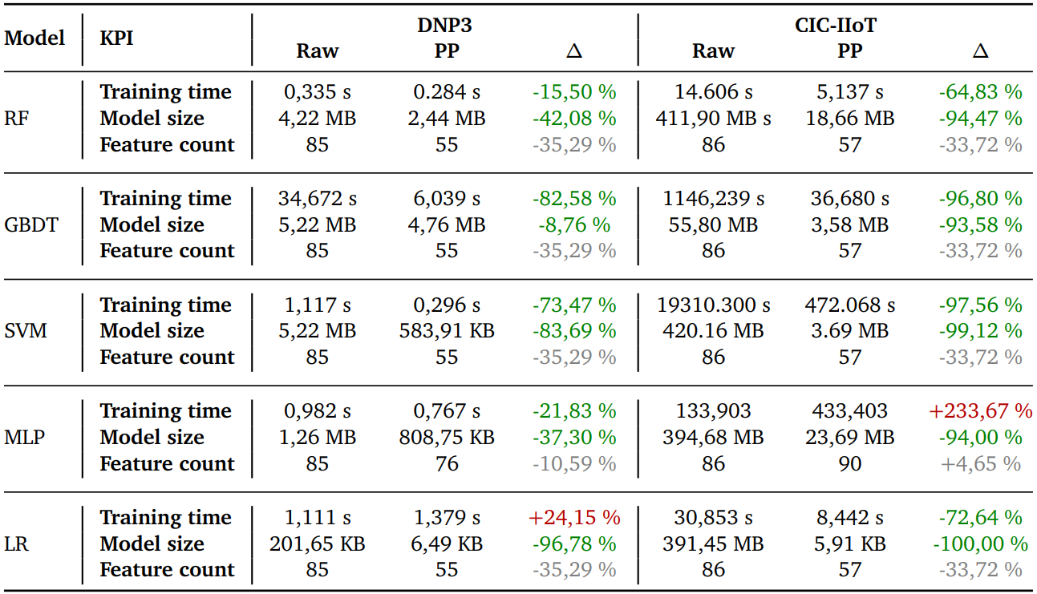
Case Study
Ressource Cost
DNP3 [1] (balanced / clean data):
Training time drops for most models
Models get smaller
Features drop
Outlier: LR training time +24% (2 10th of a second)
CIC-IIoT [2] (unbalanced / noisy data):
Training time drop significantly
Model size collapses
Features fall (MLP slight increase)
Outlier: MLP training time +234%
Preprocessing makes training faster, models smaller, and inputs leaner, especially on CIC-IIoT
Notes:
17:15
MLP:
Denser Features after PP:
Mixed/Raw fields one-hot + stadartized floats
Creats dense tensors
More Epochs

Slide 35
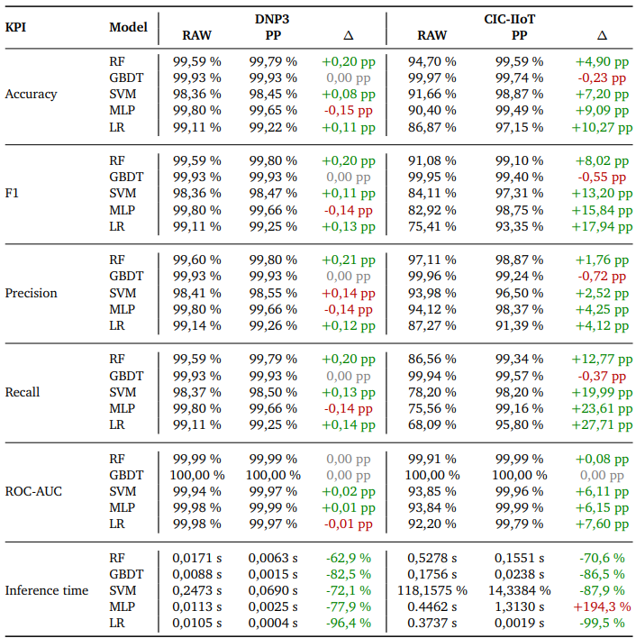
Case Study
Predictive Performance
DNP3 [1]: already near ceiling.
Changes are small: many +0.0 to +0.2 pp
Inference often faster
Takeaway: efficiency gain without hurting accuracy.
CIC-IIoT [2]: clear quality lift.
Recall jumps big for non-tree models
F1 rises
ROC-AUC improves for SVM/MLP/LR
Trees stay strong and become much lighter
Trade-off: MLP inference can be slower on CIC-IIoT (+);
others get faster (−70% to −99%).
On the hard dataset, PRE reduces misses (higher recall) and boosts F1/AUC while keeping most models faster at inference
Notes:
18:15

Slide 36
Challenges and Limitations

Slide 37
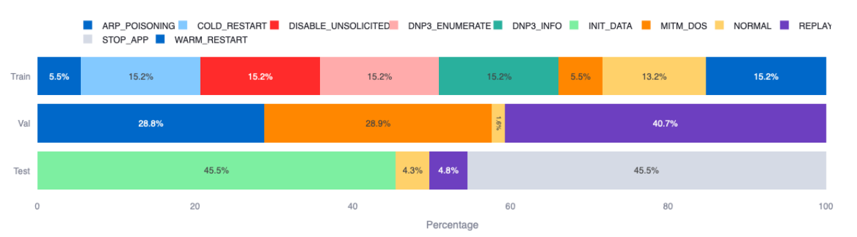
Challenges and Limitations
Dataset availability and realism
Application performance (Streamlit & session state)
Comparisons require training on PP and RAW
Time based split and unseen labels
Scope of learning methods
DNP3 [1] time based split distribution (60/20/20) with 0 gap
Notes:
19:00

Slide 38
Future Work

Slide 39
Future Work
Test A.R.C. on real data
Extend beyond supervised learning to unsupervised
Integrate CICFlowMeter
Notes:
19:30
Generate standardized flow features from PCAPs with full provenance

Slide 40
Conclusion

Slide 41
Conclusion
A.R.C. is a dataset-first, standardized pipeline for cybersecurity data
Schema/label validation and leakage-aware splits improve evaluation quality
Standardized preprocessing improves predictive performance
On clean datasets (DNP3) little improvement
On unbalanced datasets (CIC-IIoT) significant improvement
Standardized preprocessing reduces resource costs
It is possible to produce fully reproducible, audit-ready runs with minimal manual effort
From raw data to reliable decisions: A.R.C. makes models smaller, faster, and more defensible.
So we can trust what we deploy!
Notes:
20:00

Slide 42

Discussion
On GitLab you can find:
Source Code
Docker Image
Docker File
Used Datasets
Documentation
https://gitlab.cs.fau.de/es53ohum/a.r.c

Slide 43
Sources
[1] P. Radoglou-Grammatikis, V. Kelli, T. Lagkas, V. Argyriou, and P. Sarigiannidis,Dnp3 intrusion detection dataset, 2022. DOI: 10.21227/s7h0-b081. [Online].Available: https://dx.doi.org/10.21227/s7h0-b081.
[2] Canadian Institute for Cybersecurity, Cic iiot dataset 2025, University ofNew Brunswick, 2025. [Online]. Available: https://www.unb.ca/cic/datasets/iiot-dataset-2025.html.
[3] Tensorflow, https://www.tensorflow.org/, Accessed: 2025-10-01.
[4] Kubeflow, https://www.kubeflow.org/, Accessed: 2025-10-01.
[5] Mlflow, https://mlflow.org/, Accessed: 2025-10-01.
[6] Apache airflow, https://airflow.apache.org/, Accessed: 2025-10-01.

Slide 44
Vielen Dank
für Ihre Aufmerksamkeit!

Slide 45
APPENDIX

Slide 46
MODELS

Slide 47
Models
Random Forest (RF)
Ensemble of many decision trees
How it works
Trains trees on bootstrap samples
votes/averages predictions
Random feature subsets at each split
→ decorrelated trees
What it’s used for
Strong tabular baseline
Handles non-linear rules & mixed features
Robust to outliers
Little need for scaling
Offers feature importance
Strengths
Fast to train
Parallelizable
Stable performance out-of-the-box
Limits / notes
Larger models (can memorize duplicates/IDs if not cleaned)
Fewer gains from scaling
Benefits from deduplication and cardinality controls

Slide 48
Models
Gradient Boosted Decision Trees (GBDT)
Sequential ensemble of shallow trees that correct previous errors
How it works
Fit tree to the gradient/residual of current model
Additive model
What it’s used for
Top performer on many tabular problems
Captures complex interactions
Strengths
High accuracy with careful regularization
Handles mixed feature types
Limits / notes
More hyperparameter-sensitive than RF
Can overfit noisy IDs
Prefers cleaned and compact features

Slide 49
Models
Support Vector Machine (SVM)
Margin-based classifier, linear or kernelized (e.g., RBF)
How it works
Finds maximum-margin hyperplane
What it’s used for
High-dimensional tabular data after scaling/encoding
Strong when classes are separable in a transformed space
Strengths
Good generalization
Effective with proper scaling
Limits / notes
Needs standardized inputs
Training can be slow on large datasets
Sensitive to duplicates/leakage

Slide 50
Models
Multi-Layer Perceptrons (MLP)
Feed-forward neural network
How it works
Optimizes weights by gradient descent on a loss
Requires numeric, standardized inputs
What it’s used for
Capturing non-linear interactions in tabular data
Strengths
Flexible function approximator
Can improve recall on noisy data
Limits / notes
Hyperparameter/compute sensitive
Needs scaling
Risk of overfit without regularization
With denser, wider inputs after PRE, training/inference can get slower

Slide 51
Models
Logistic Regression (LR)
Linear probabilistic classifier with logistic link
How it works
Learns weights via convex optimization
Outputs calibrated probabilities
Needs numeric, standardized features
What it’s used for
Interpretable baseline
Fast training and very fast inference
Strengths
Simple, explainable coefficients
Strong with well prepared features
Limits / notes
Linear decision boundary
Relies on good encoding/feature engineering
Sensitive to scale without preprocessing

Slide 52
RELATED WORK DETAIL

Slide 53
Related Work
TensorFlow Extended (TFX)
End-to-end ML pipeline toolkit.
Core pieces: TFDV, TFT, TFMA, MLMD.
Portable across Airflow/Beam/Kubeflow.
Strengths:
schema/anomaly/drift checks
deterministic transforms
sliced evaluation
lineage.
Gaps for A.R.C.:
no native time-aware split/embargo
no cross-split dedupe
no first-class RAW vs PRE
domain label/timestamp checks need custom code

Slide 54
Related Work
Kubeflow Pipelines (KFP)
Kubernetes-native, containerized ML DAGs. Python DSL → IR YAML. UI for runs/artifacts. Caching/parallelism.
No prescribed validation or preprocessing; bring your own components.
Reproducibility via containers, typed I/O, metadata, caching.
Domain fit: cybersecurity checks (time-based splits, label canon, drift/leakage) must be implemented.
Not a substitute for A.R.C.; good infrastructure to host it.

Slide 55
Related Work
MLflow
Lifecycle tooling: Tracking, Models (flavors), Model Registry; compare runs in UI.
Focus: logging params/metrics/artifacts; packaging; governance.
No built-in data validation, preprocessing, or splitting. Log outputs from your code.
Reproducibility: immutable run records, packaged envs, registry lineage; evaluation utilities.
Role with A.R.C.: governance/record layer, not a prep/orchestration replacement.

Slide 56
Related Work
Apache Airflow
General workflow orchestrator: DAGs, operators/sensors, scheduler, metadata DB, web UI.
No native validation/preprocessing/splitting; implement tasks yourself.
Reproducibility/ops: persisted run history, per-task logs, metrics.
Domain-agnostic; complements A.R.C. as the scheduling backbone.

Slide 57
PREPROCESSING STEPS

Slide 58
CLEANING

Slide 59
Preprocessing steps
Drop Duplicates
Removes identical rows so patterns aren’t overweighted; reduces leakage across splits.
RF / GBDT:
Needed
Duplicates bias tree splits toward frequent patterns
SVM / MLP / LR:
Needed
Duplicates overweight the loss
Harms generalization

Slide 60
Preprocessing steps
Impute Missing Values
Fills NaNs to keep rows usable
RF / GBDT:
Needed
Scikit-learn trees don’t train with NaNs
SVM / MLP / LR:
Needed
All require complete numeric tensors

Slide 61
ENCODING

Slide 62
Preprocessing steps
Bucket Rare Categories
Merges infrequent categories into “Other” to reduce cardinality and leakage from one-offs.
RF / GBDT:
Recommended
Stabilizes splits
Shrinks trees
SVM / MLP / LR:
Recommended
Lowers dimensionality after encoding
Better conditioning

Slide 63
Preprocessing steps
One-Hot Encoding (OHE)
Converts categorical to binary indicator columns
RF / GBDT:
Often optional
Trees can split on categories post-encoding
But OHE may explode width
SVM / MLP / LR:
Needed
Standard for linear/separable inputs
Avoids spurious ordinality.

Slide 64
Preprocessing steps
CatBoost encoding
Replaces category with smoothed target statistics (with ordering/K-folding)
RF / GBDT:
Optional
Compact vs OHE but needs careful leakage control
SVM / MLP / LR:
Usually not used
Leakage risk
OHE safer / clearer

Slide 65
Preprocessing steps
Count Encoding
Replaces category with global frequency
RF / GBDT:
Can be useful
Compact signal
Low leakage risk
SVM / MLP / LR:
Useful when OHE would explode
Still scale afterward

Slide 66
Preprocessing steps
Target Mean Encoding
Category → mean(target)
All models:
Generally not used
High leakage risk unless strictly out-of-fold with strong regularization

Slide 67
FEATURE SELECTION

Slide 68
Preprocessing steps
Drop Constant / Low-Variance Features
Removes features with (near) zero variance
RF / GBDT:
Recommended
Avoids useless splits
Speeds training
SVM / MLP / LR:
Needed
Improves conditioning and training stability

Slide 69
Preprocessing steps
Drop Highly Correlated Numerics
Removes one of each highly correlated pair to cut redundancy
RF / GBDT:
Recommended
shallower trees
less overfit
SVM / MLP / LR:
Needed
reduces multicollinearity
improves convergence
Notes:
For MLP more of a tuning knob not a requirement

Slide 70
Preprocessing steps
Feature Selection by RF Importance
Rank features via RF and keep top-k
RF / GBDT:
Optional
Can trim width
SVM / MLP / LR:
Can be useful
Cuts noise and dimensions before training

Slide 71
Preprocessing steps
Feature Selection by Mutual Information
Keeps features with high MI to the label (captures non-linear dependence)
RF / GBDT:
Optional
Trees model non-linearities internally
SVM / MLP / LR:
Useful
Good prefilter when many weak signals

Slide 72
Preprocessing steps
Feature Selection by ANOVA F
Selects features with strong between-class mean separation
RF / GBDT:
Usually not needed
Non-linear splits dominate
SVM / MLP / LR:
Useful
Classic linear prefilter

Slide 73
Preprocessing steps
PCA Reduction
Projects numerics to orthogonal components; reduces dimension
RF / GBDT:
Usually not used
Loses split interpretability
Trees prefer original axes
SVM / MLP / LR:
Sometimes useful
Fewer dimensions
Better conditioning

Slide 74
SCALING / NORMALIZATION

Slide 75
Preprocessing steps
Scaling
Zero-mean / unit-variance per feature
RF / GBDT:
Not needed
Trees are scale-invariant
SVM / MLP / LR:
Needed
Essential for stable optimization and fair margins

Slide 76
Preprocessing steps
Row-Wise L2 Normalization
Scales each sample vector to unit norm (emphasizes direction over magnitude)
RF / GBDT:
Not needed
SVM:
Sometimes helpful
Particularly with linear approximations
MLP / LR:
Optional
Can help when magnitudes vary wildly

Slide 77
OUTLIER / TRANSFORMATION

Slide 78
Preprocessing steps
Outlier Clipping
Caps extreme values to reasonable bounds
RF / GBDT:
Optional
Trees robust, but clipping can stabilize splits
SVM / MLP / LR:
Recommended
Protects from heavy tails
Speeds/steadies training

Slide 79
Preprocessing steps
Log1p Transformation
Compresses heavy-tailed numerics (log(1+x))
RF / GBDT:
Optional
Minor impact
SVM / MLP / LR:
Can be useful
Reduces skew
Improves linear separability and gradients

Slide 80
CLASS IMBALANCE

Slide 81
Preprocessing steps
Class Weights
Up-weights minority class in the loss
RF / GBDT:
Useful
Fairer splits on rare attacks
SVM / MLP / LR:
Needed
Boosts recall on minority classes without resampling

Slide 82
Preprocessing steps
Resampling
Rebalances the training set
RF / GBDT:
Optional
Can help but watch overfit
SVM / MLP / LR:
Useful when class weights aren’t enough
Monitor drift in feature space

Slide 83
SVM KERNEL APPROXIMATION

Slide 84
Preprocessing steps
SVM Kernel Approximation
Approximates RBF kernel with finite features and trains a linear SVM on them
RF / GBDT / MLP / LR:
Not applicable
SVM:
Useful
Kernel-like power with faster training/inference

Slide 85
TIME FEATURES

Slide 86
Preprocessing steps
Add Time Features
Derives calendar/lag/interval features; exposes temporal structure
RF / GBDT:
Recommended
Informative splits and interactions
SVM / MLP / LR:
Recommended
Improves separability
Supports recall

Slide 87
PREPROCESSING ORDER

Slide 88
Preprocessing Steps
Order
Encode labels
Time Features
Drop Duplicates
Missing Values
Bucket Rare Categories
Encoding
Encodings that add features (e.g. count encoding)
Feature selection
Outlierer & Transformations
Scaling & Normalisation
Kernel Approximation
Balancing

Slide 89
FULL RESULTS

Slide 90
SCHEMA VALIDATOR

Slide 91
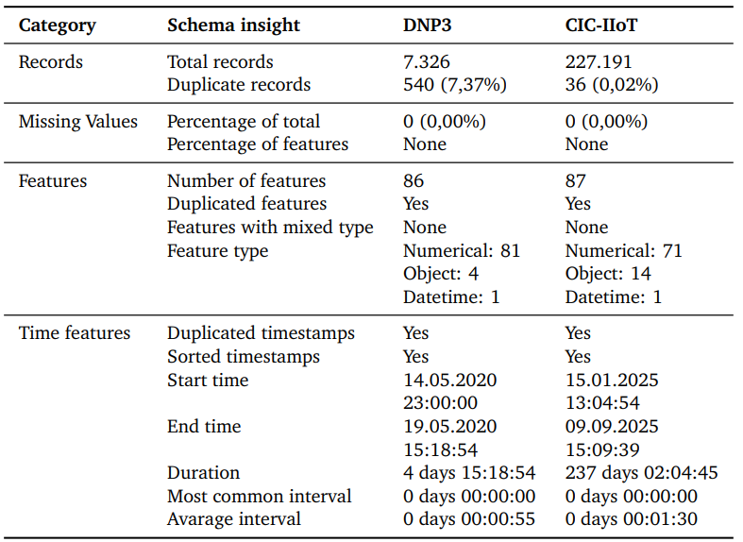
Results
Schema Validator Insights
Overview of schema validator insights

Slide 92
LABEL VALIDATOR

Slide 93
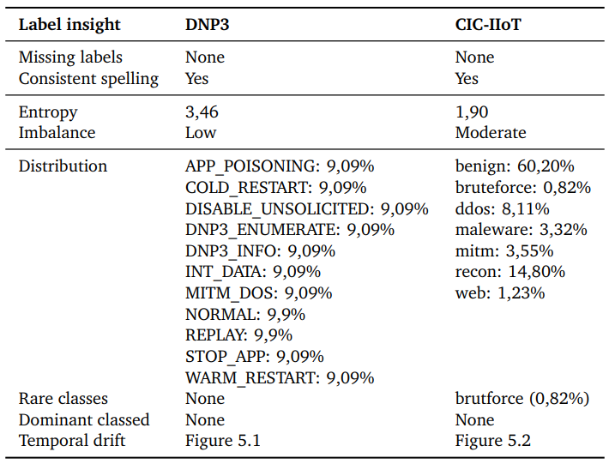
Results
Label Validator Insights
Overview of label validator insights

Slide 94
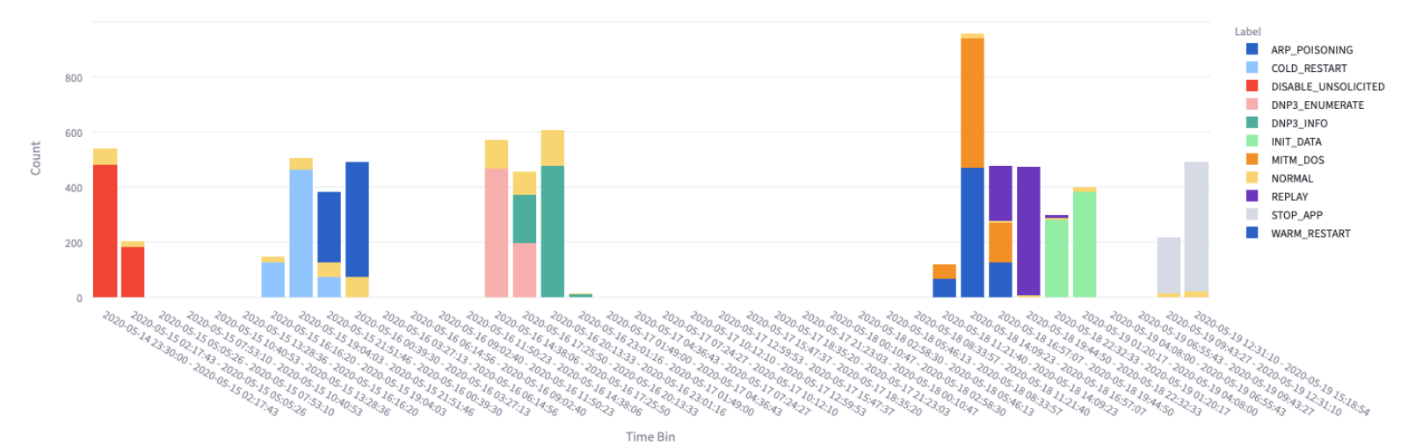
Results
Label Validator Insights
DNP3 label distribution across 40 time bins

Slide 95
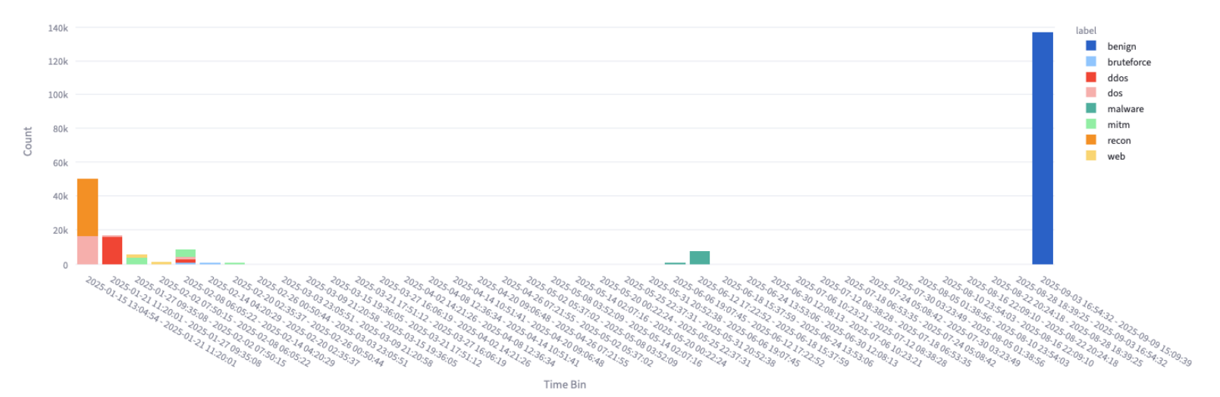
Results
Label Validator Insights
CIC-IIoT label distribution across 40 time bins

Slide 96
SPLITTER

Slide 97
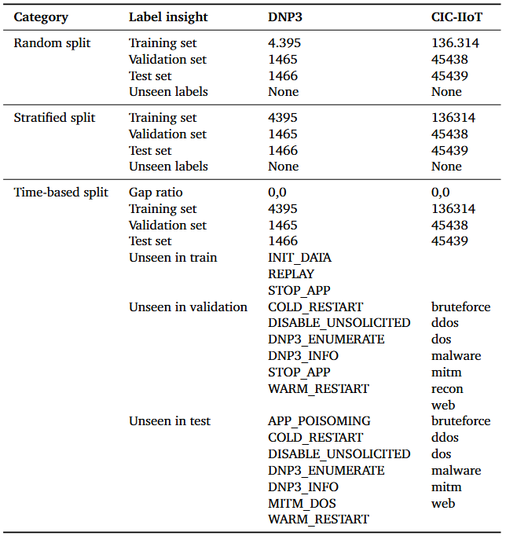
Results
Splitter Insights
Overview of splits and label coverage across strategies

Slide 98
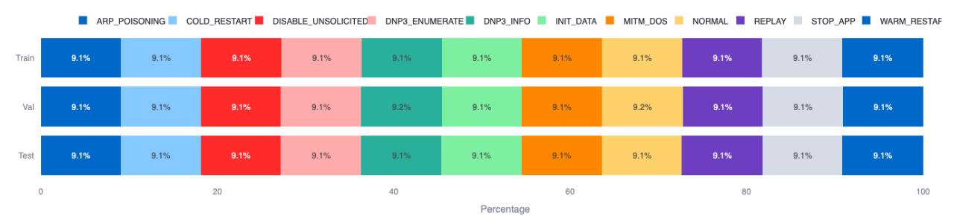
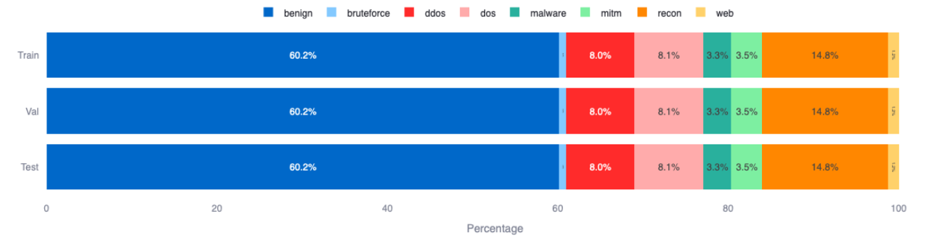
Results
Splitter Insights
DNP3 stratified split distribution (60/20/20)
CIC-IIoT stratified split distribution (60/20/20)

Slide 99
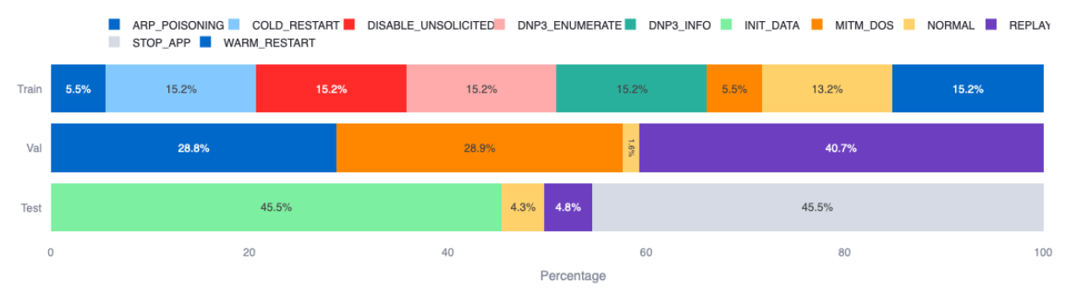
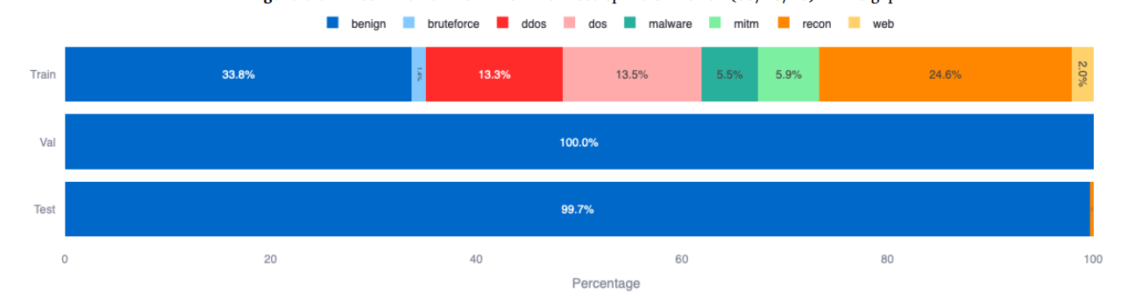
Results
Splitter Insights
DNP3 time based split distribution (60/20/20)
CIC-IIoT time based split distribution (60/20/20)

Slide 100
IMPACT RF

Slide 101
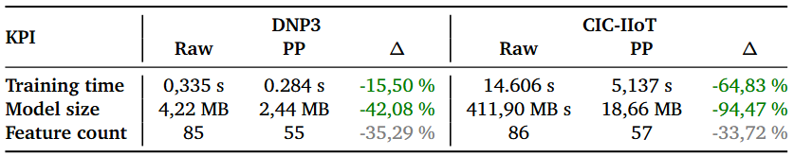
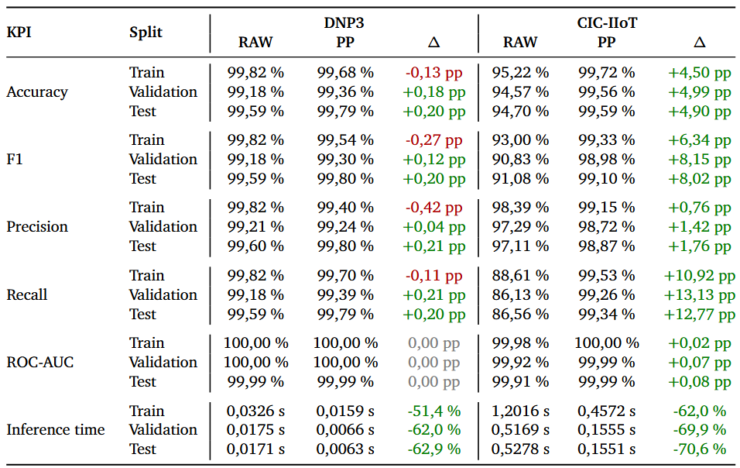
Results
Impact Random Forest
Overview of resource footprint of RF before (RAW) and after A.R.C.’s standardized preprocessing (PP) under a 60/20/20 stratified split
Overview of predictive performance of RF with (PP) and without (RAW) preprocessing on train, validation and test under a 60/20/20 stratifiedsplit

Slide 102
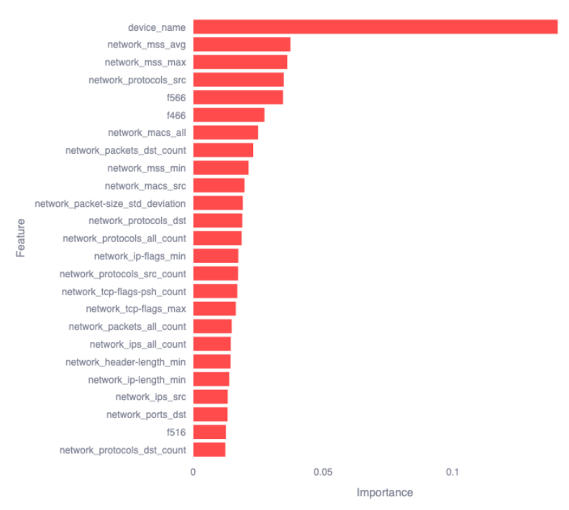
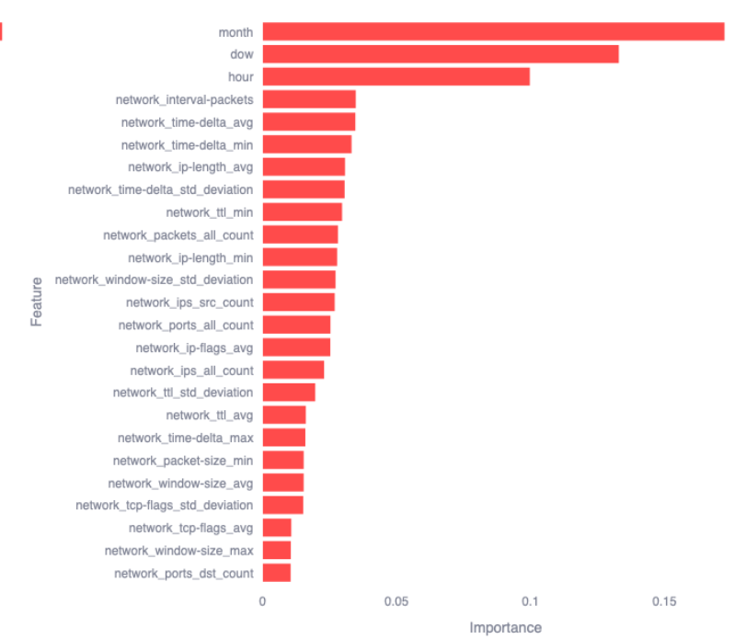
Results
Impact Random Forest
Illustration of the top 25 most important features comparison between RAW (left) and PP (right) for RF on DNP3 under stratified splitting (60/20/20) on the test subset

Slide 103
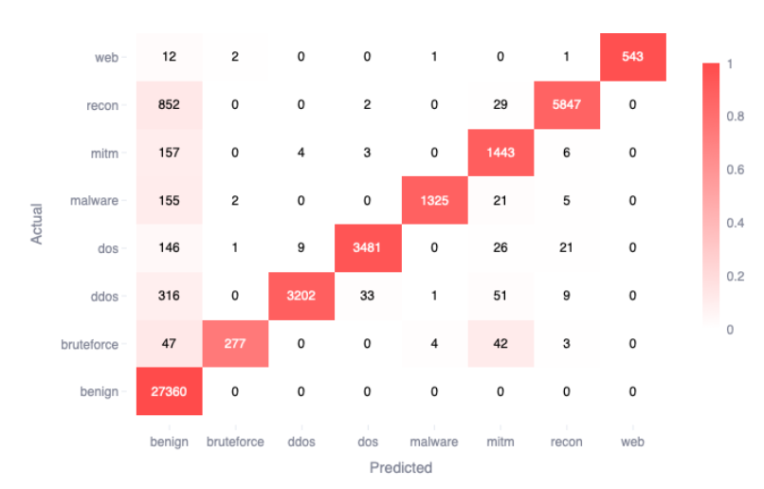
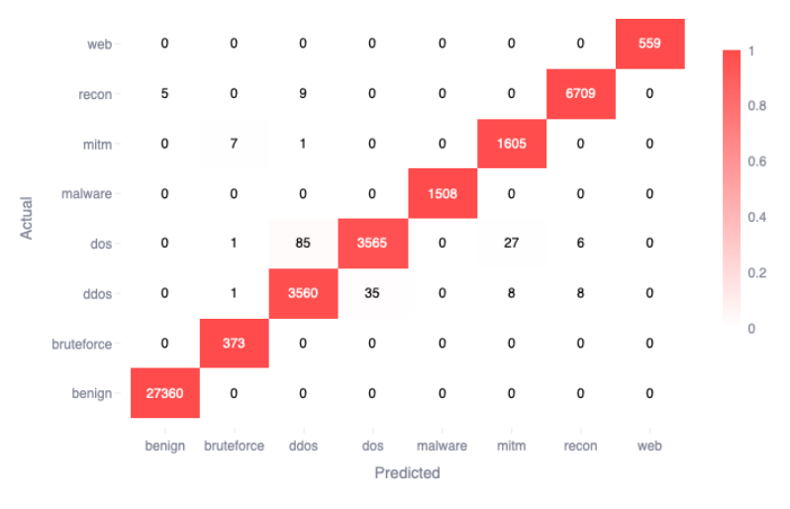
Results
Impact Random Forest
Illustration of the confusion matrix comparison between RAW (left) and PP (right) for RF on CIC-IIoT under stratified splitting (60/20/20) on the test subset

Slide 104
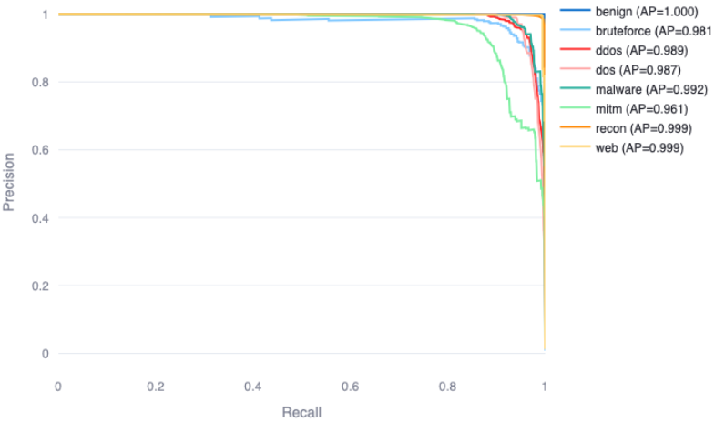
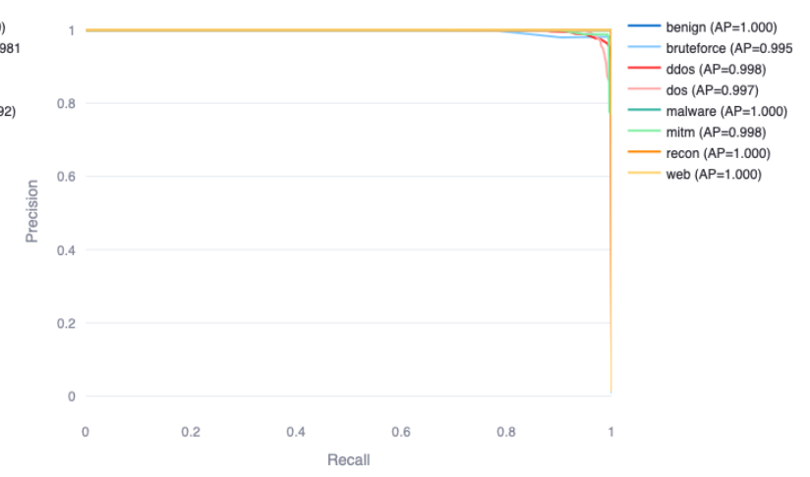
Results
Impact Random Forest
Illustration of the PR curve comparison between RAW (left) and PP (right) for RF on CIC-IIoT under stratified splitting (60/20/20) on the test subset

Slide 105
IMPACT GBDT

Slide 106
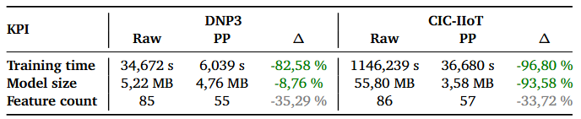
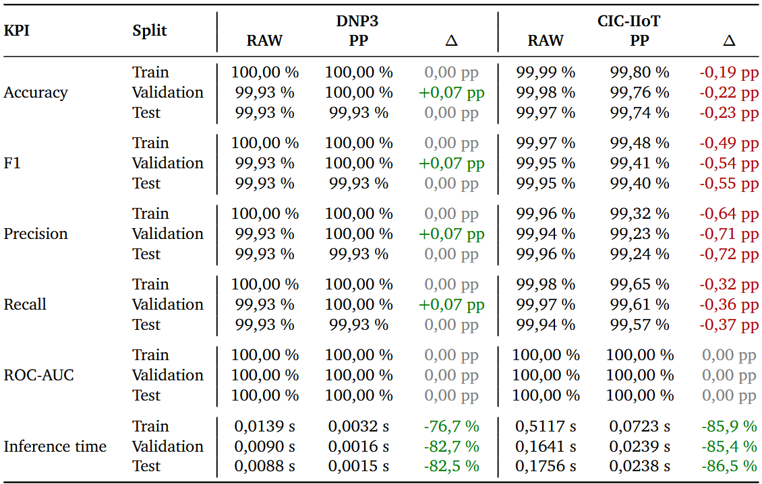
Results
Impact Gradient Boosted Descion Trees
Overview of resource footprint of GBDT before (RAW) and after A.R.C.’s standardized preprocessing (PP) under a 60/20/20 stratified split
Overview of predictive performance of GBDT with (PP) and without (RAW) preprocessing on train, validation and test under a 60/20/20 stratified split

Slide 107
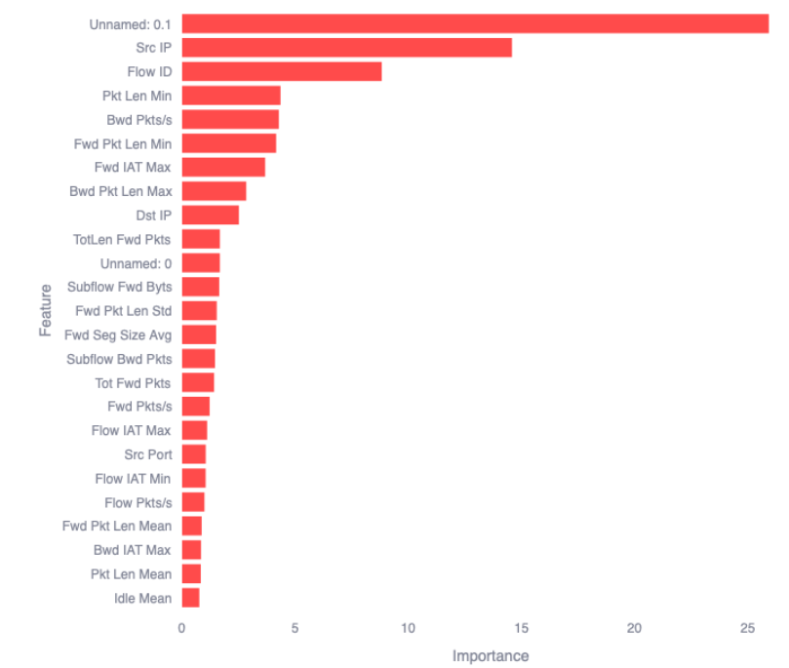
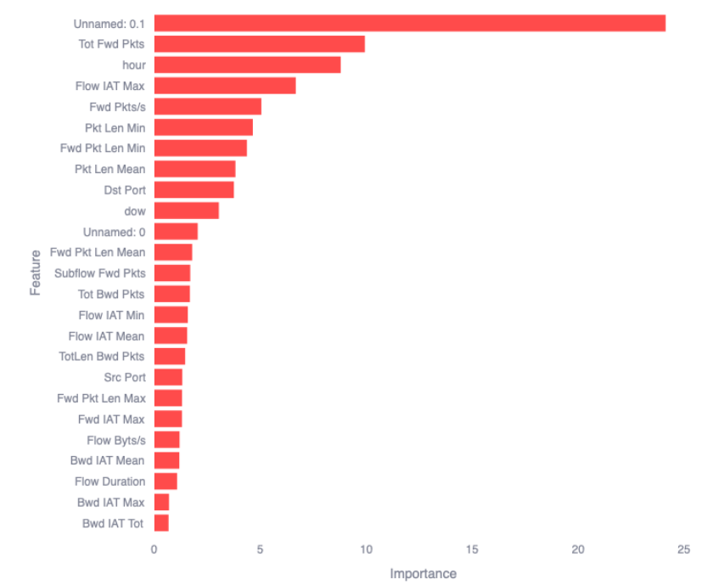
Results
Impact Gradient Boosted Descion Trees
Illustration of the top 25 most important features comparison between RAW (left) and PP (right) for GBDT on DNP3 under stratified splitting (60/20/20) on the test subset

Slide 108
IMPACT SVM

Slide 109
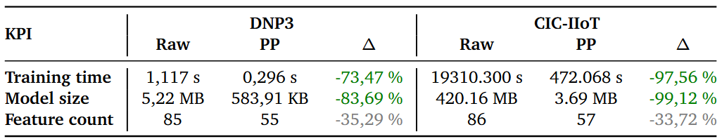
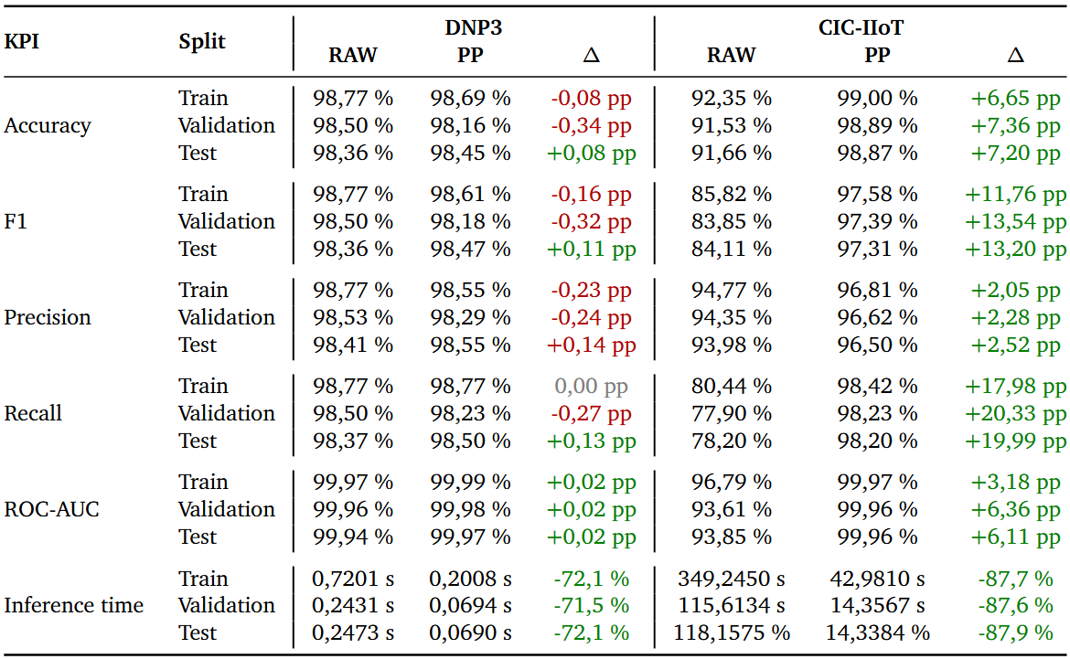
Results
Impact Support Vector Machines
Overview of resource footprint of SVM before (RAW) and after A.R.C.’s standardized preprocessing (PP) under a 60/20/20 stratified split
Overview of predictive performance of SVM with (PP) and without (RAW) preprocessing on train, validation and test under a 60/20/20 stratified split

Slide 110
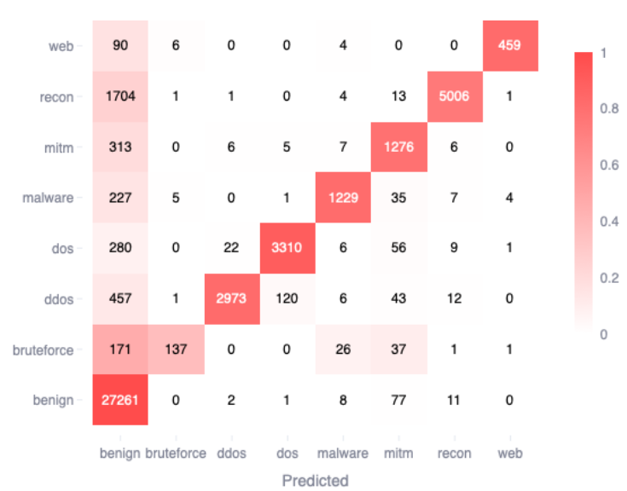
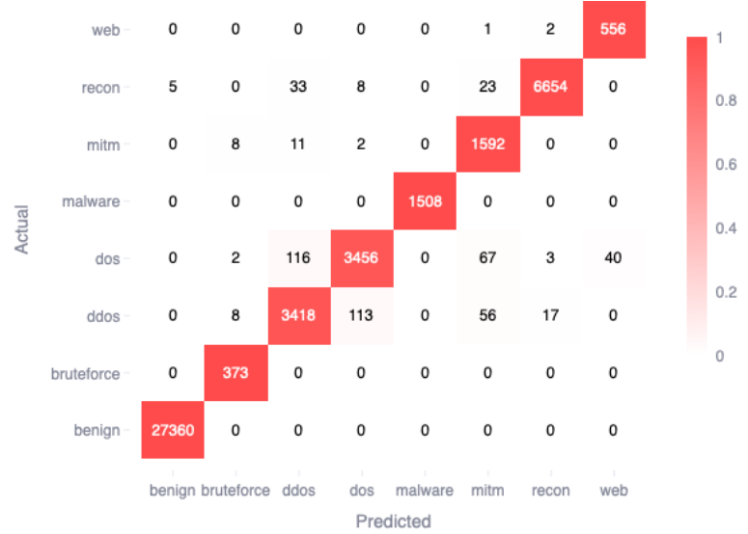
Results
Impact Support Vector Machines
Illustration of the confusion matrix comparison between RAW (left) and PP (right) for SVM on CIC-IIoT under stratified splitting (60/20/20) on the test subset

Slide 111
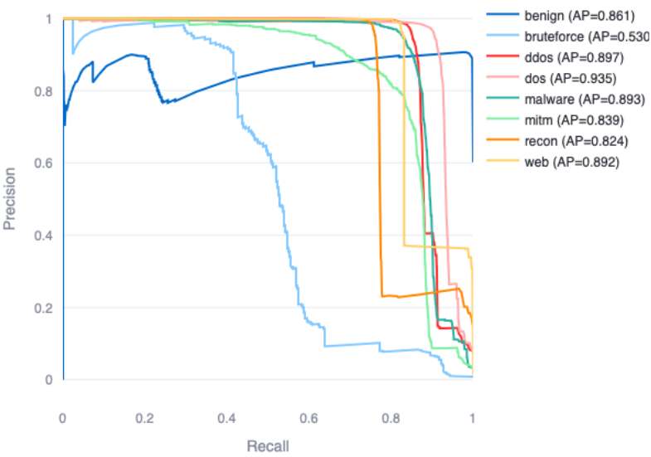
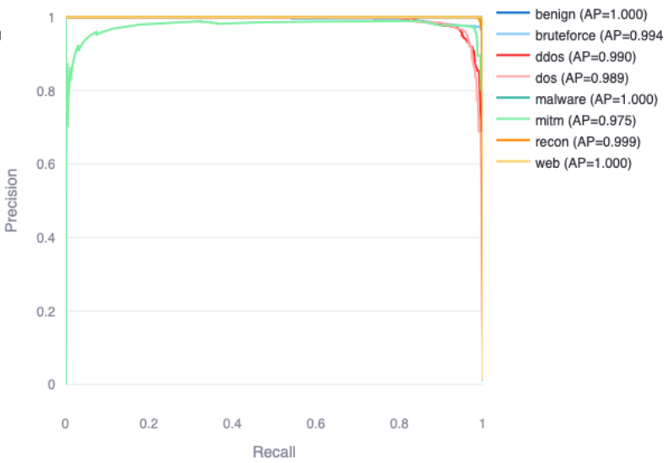
Results
Impact Support Vector Machines
Illustration of the SVM curve comparison between RAW (left) and PP (right) for SVM on CIC-IIoT under stratified splitting (60/20/20) on the test subset

Slide 112
IMPACT MLP

Slide 113
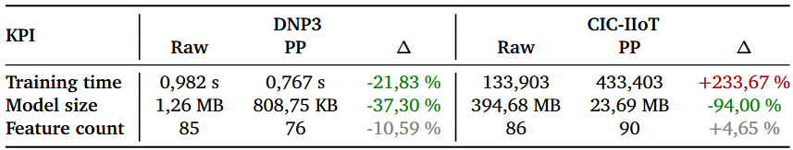
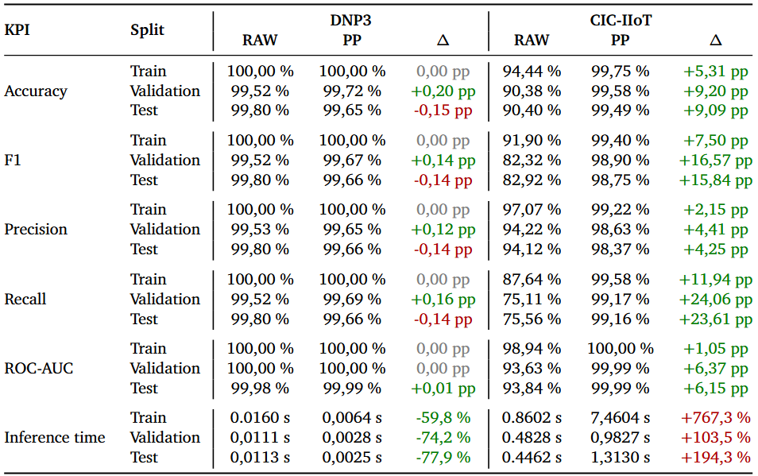
Results
Impact Multi Layer Perceptrons
Overview of resource footprint of MLP before (RAW) and after A.R.C.’s standardized preprocessing (PP) under a 60/20/20 stratified split
Overview of predictive performance of MLP with (PP) and without (RAW) preprocessing on train, validation and test under a 60/20/20 stratified split

Slide 114
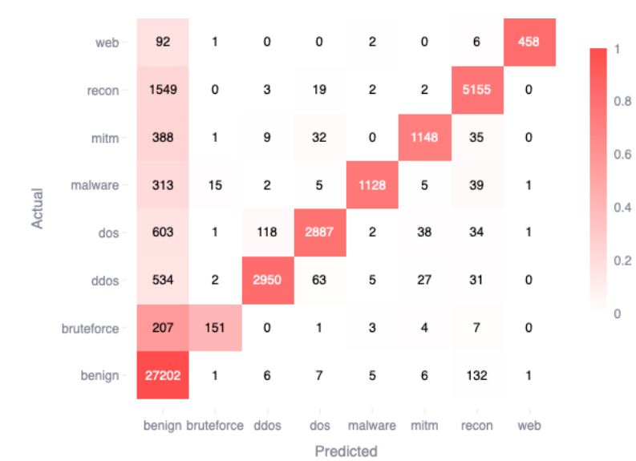
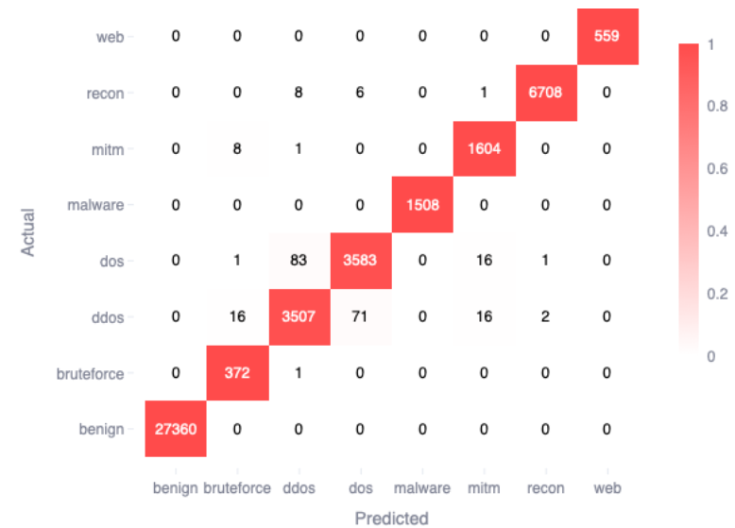
Results
Impact Multi Layer Perceptrons
Illustration of the confusion matrix comparison between RAW (left) and PP (right) for MLP on CIC-IIoT under stratified splitting (60/20/20) on the test subset

Slide 115
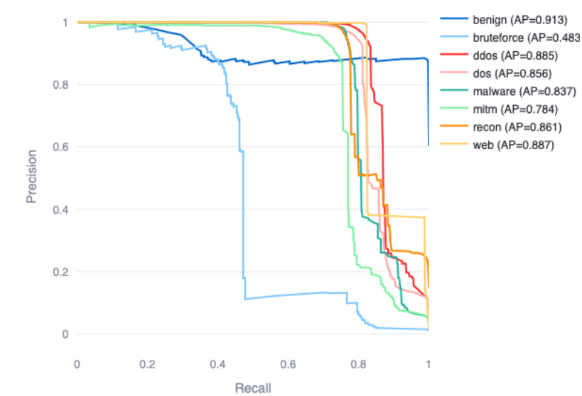
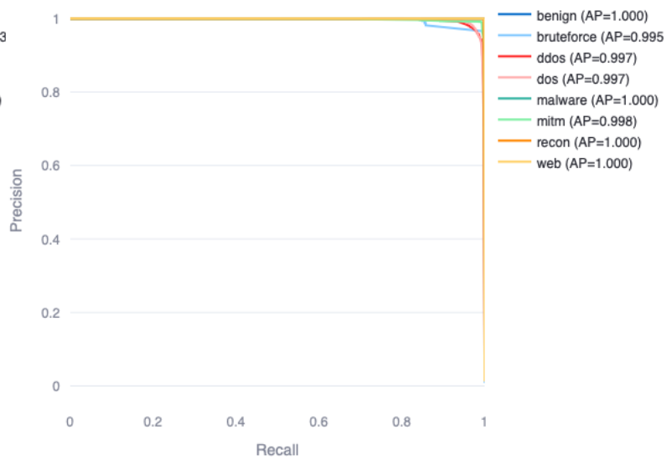
Results
Impact Multi Layer Perceptrons
Illustration of the SVM curve comparison between RAW (left) and PP (right) for MLP on CIC-IIoT under stratified splitting (60/20/20) on the test subset

Slide 116
IMPACT LR

Slide 117
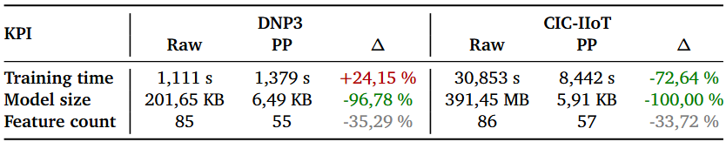
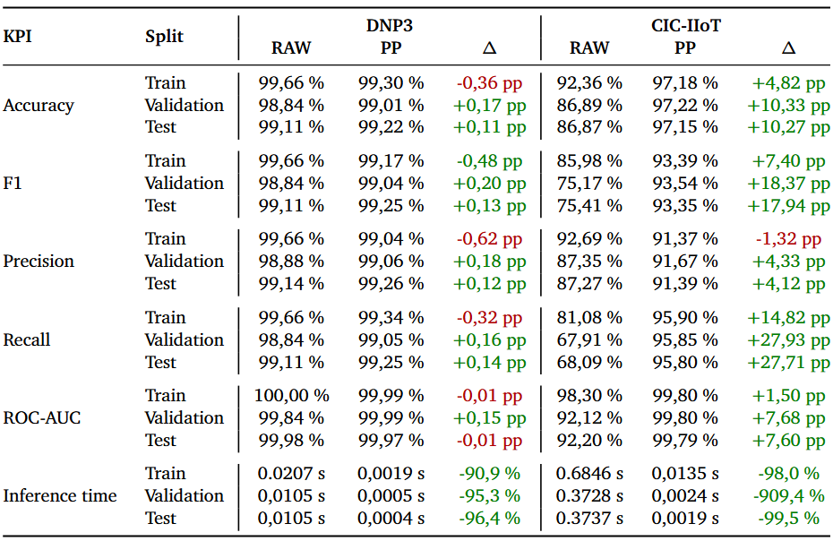
Results
Impact Logistic Regression
Overview of resource footprint of lR before (RAW) and after A.R.C.’s standardized preprocessing (PP) under a 60/20/20 stratified split
Overview of predictive performance of LR with (PP) and without (RAW) preprocessing on train, validation and test under a 60/20/20 stratified split

Slide 118
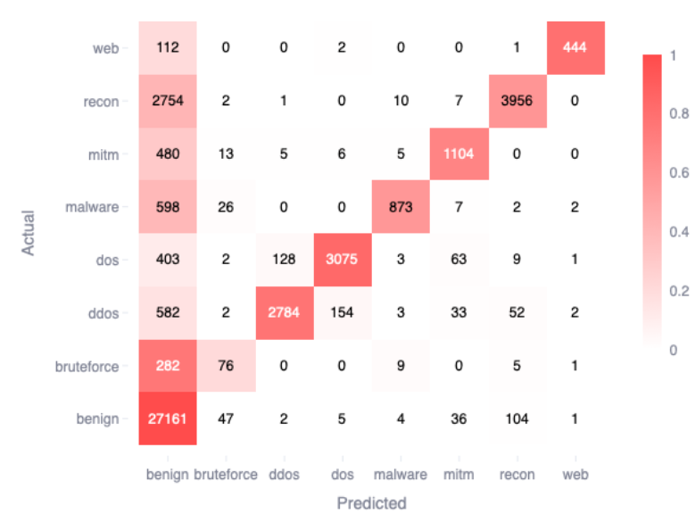

Results
Impact Logistic Regression
Illustration of the confusion matrix comparison between RAW (left) and PP (right) for LR on CIC-IIoT under stratified splitting (60/20/20) on the test subset

Slide 119


Results
Impact Logistic Regression
Illustration of the SVM curve comparison between RAW (left) and PP (right) for LR on CIC-IIoT under stratified splitting (60/20/20) on the test subset

